Slide 1
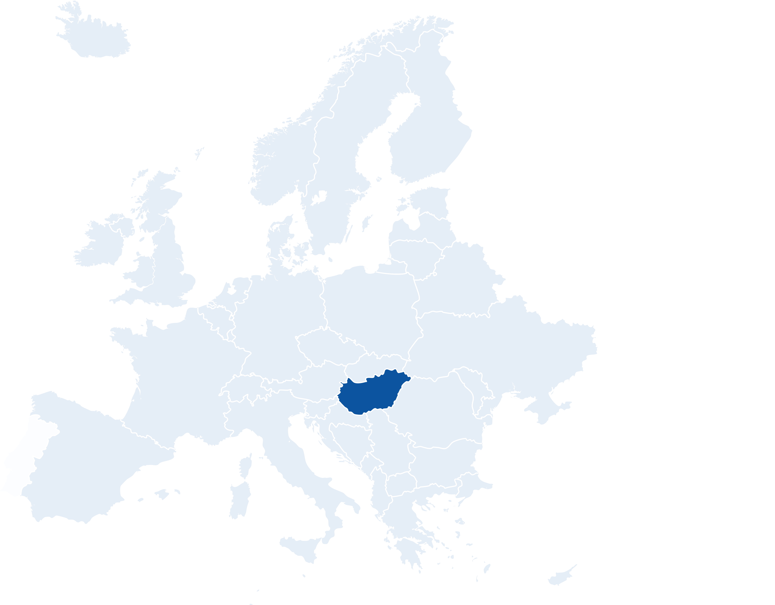
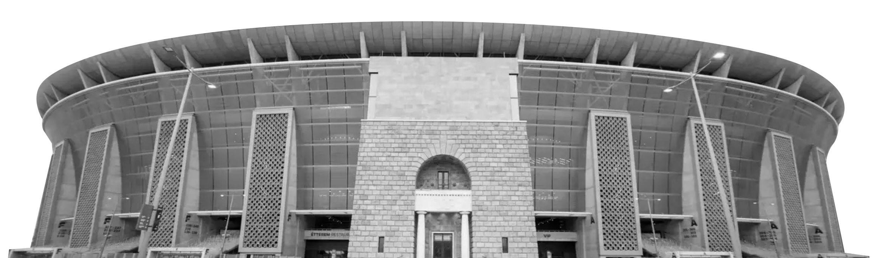
Welcome to..
budapest
Continent: Europe
Country: Hungary
Capital: Budapest
What country is Hungary next to?
What is the official language of Hungary?
Puskás Arena
Matthias Church
Notes:
Teacher Notes
Starter activity: Get students thinking about what country they are visiting.

Slide 2
Welcome to budapest
You’ve made your railway journey to the capital city of Hungary. It is famous for its art, music, parks and gardens. It is one of the Group F hosts in UEFA EURO 2020.
What teams will be playing in this group?
Use the flags below to find out…
GERMANY
HUNGARY
Budapest
GROUP f
FRANCE
PORTUGAL
Notes:
Teacher Notes
Brief introduction to Hungary as a city.
Locate Hungary and then Budapest on the map.
Use the Budapest Host City Guide to discuss the country in more detail (optional).

Slide 3
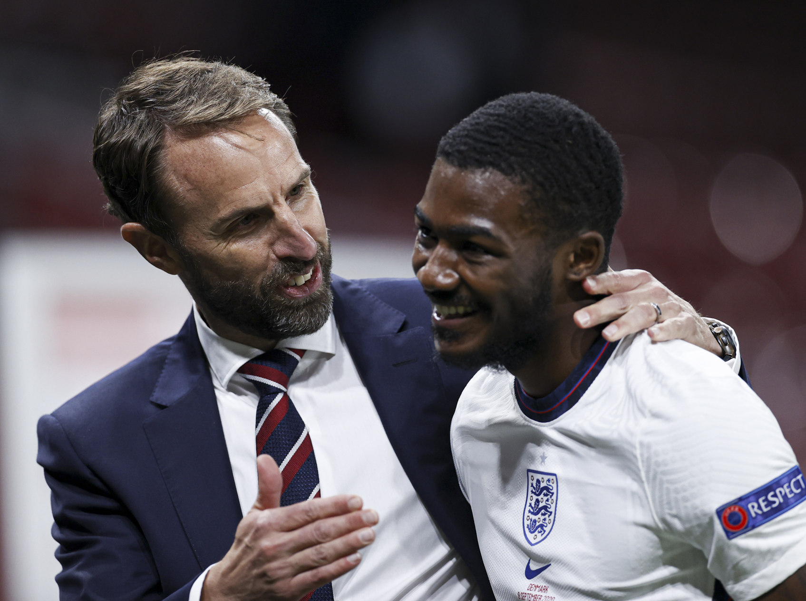
YOUR BIG QUESTION TO ANSWER IN budapest IS:
Progressive
Respectful
Inclusive
Determined
Excellent
What are values and why are they important?
You are going to find out about the key values in football and why they are important.
Learning objectives:
To understand The FA PRIDE values.
To suggest ways these values can be embraced in different situations.
Notes:
Teacher Notes
The big question to answer is a key point of the lesson.

Slide 4
What are values?
creativity
curiosity
compassion
kindness
honesty
Notes:
Teacher Notes
Discuss the idea of values:
They are like an inner compass; they are what matter to you deep in your heart.
Pupils might say they value creativity, curiosity, compassion, kindness, honesty etc.
Click to reveal these words. What others can the class think of?
Use could also use an animation from the internet to introduce the concept of values.

Slide 5
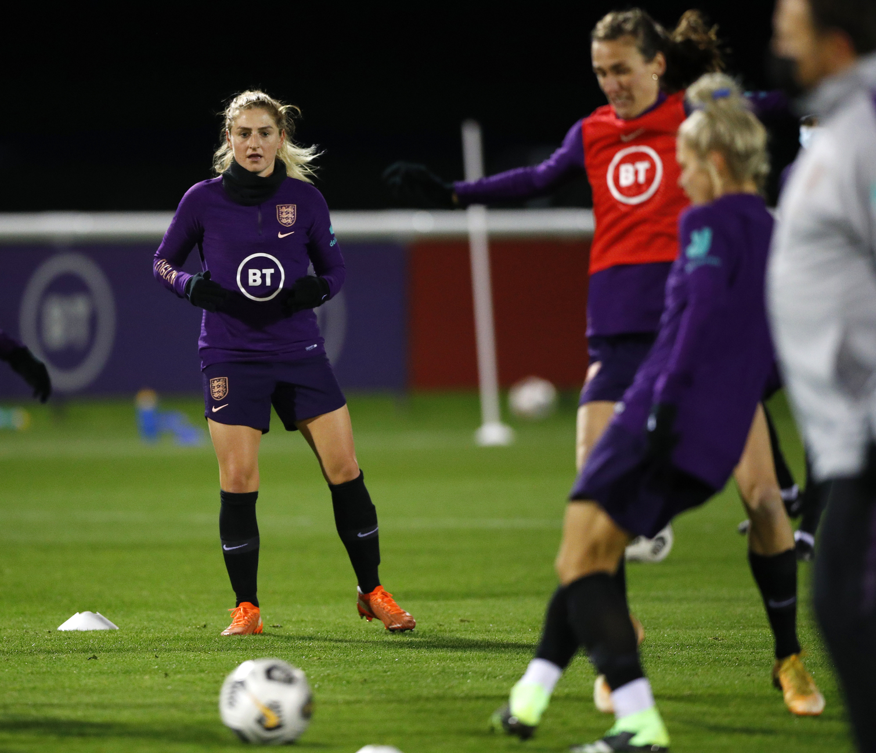
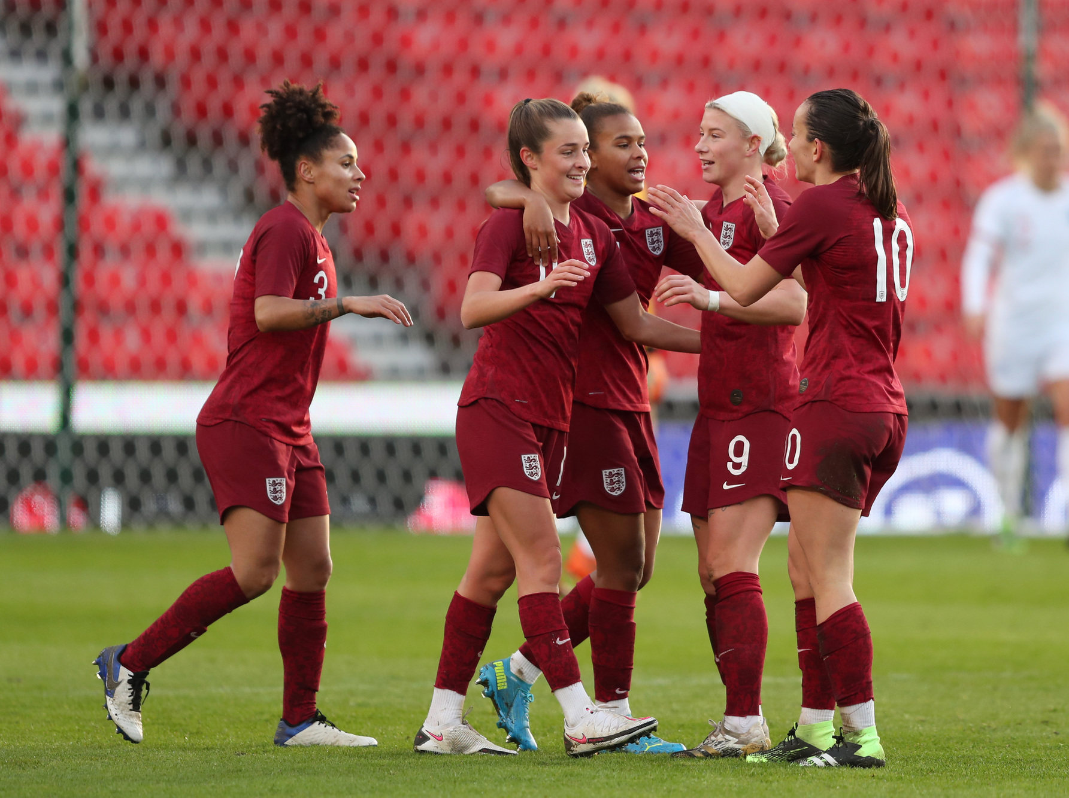
What do the fa pride values mean?
Progressive: always looking to improve and innovate.
Respectful: leading by example to inspire positive behaviour.
Inclusive: uniting all people of any age, ethnicity and background.
Determined: rising to and overcoming challenges.
Excellent: striving to make football the best it can be.
Notes:
Teacher Notes
The FA PRIDE values are ways of behaving that we can all strive towards in grassroots football, and in day to day life.

Slide 6
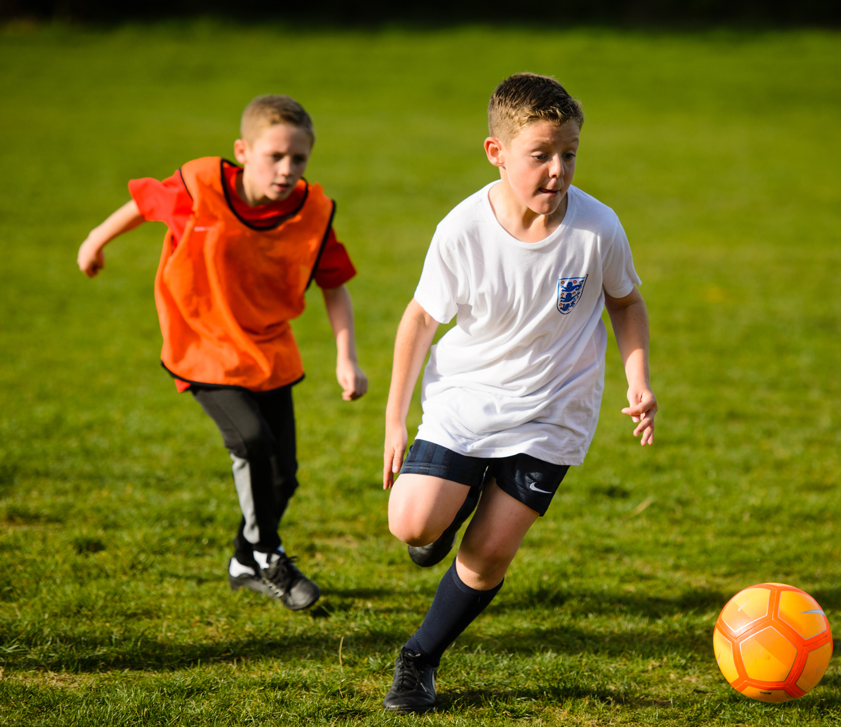
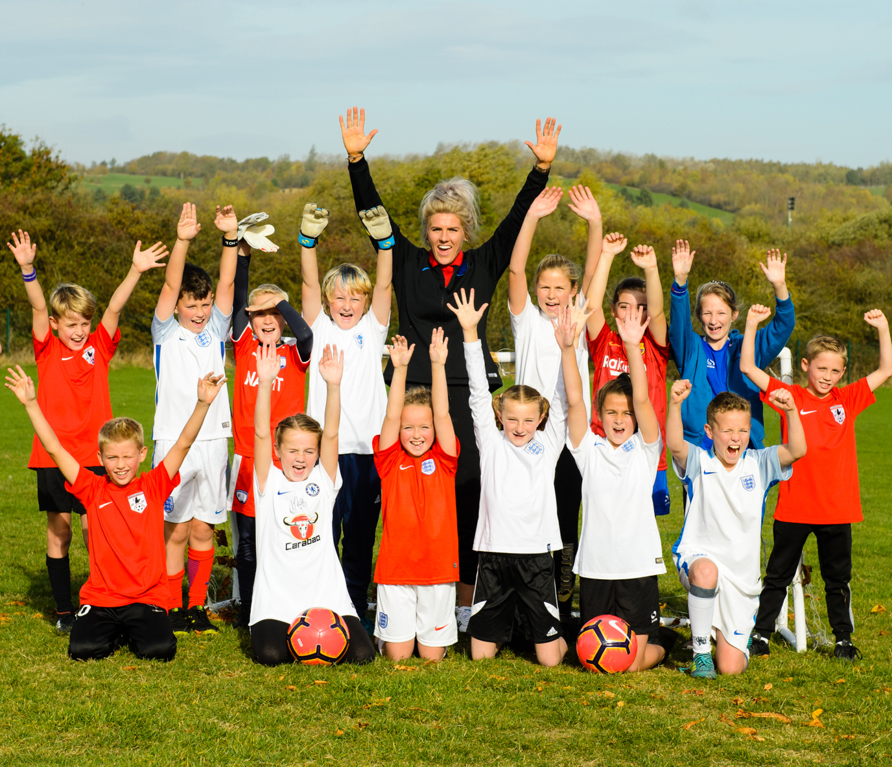
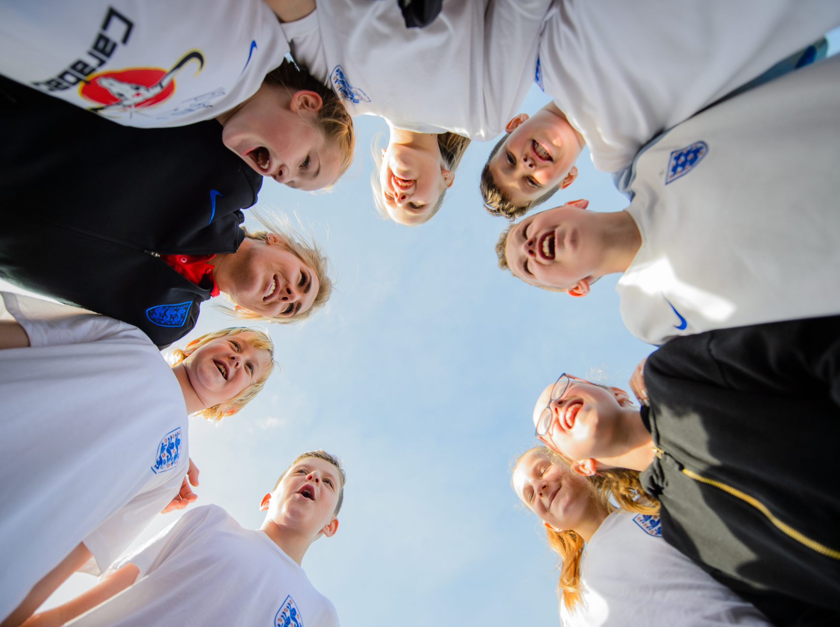
How can you embrace these values?
You are now going to look in more detail at each of The FA PRIDE values. You will be provided with a situation. You need to apply The FA PRIDE values, suggest ways the person can implement them and improve the situation.
Notes:
Teacher Notes
Explain that pupils are going to look at each value in detail and apply them to real-life situations.

Slide 7
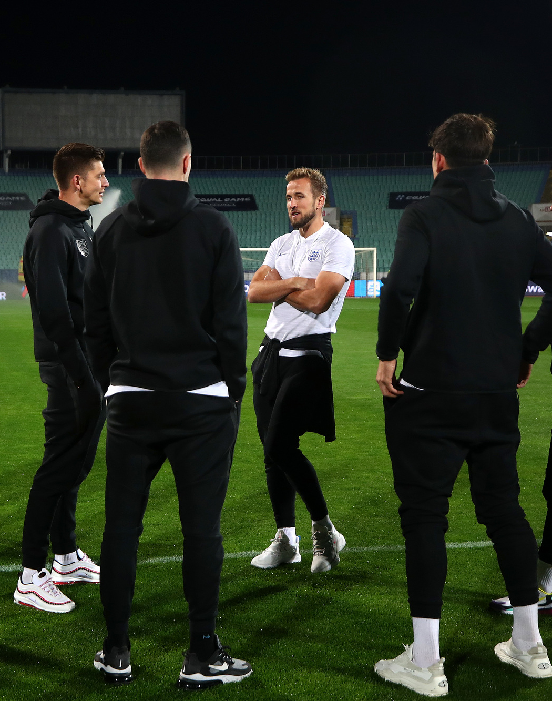
Progressive value
Always looking to improve and innovate
You are playing football in the park with your friends. Your friend Francesca shoots for goal and misses. Your other friend Sanjeev suggests that Francesca keeps her head down when shooting to improve her shot. Francesca abruptly disagrees with Sanjeev and says she won’t listen and doesn’t need to improve.
How could you follow The FA PRIDE values and improve the situation?
How would you behave in this situation?
Notes:
Teacher Notes
Help to guide students:
Suggest that Francesca embraces change and try out the suggestions.
It may work for her, if it doesn’t then she hasn’t lost anything.
If it works then she has improved and innovated.

Slide 8
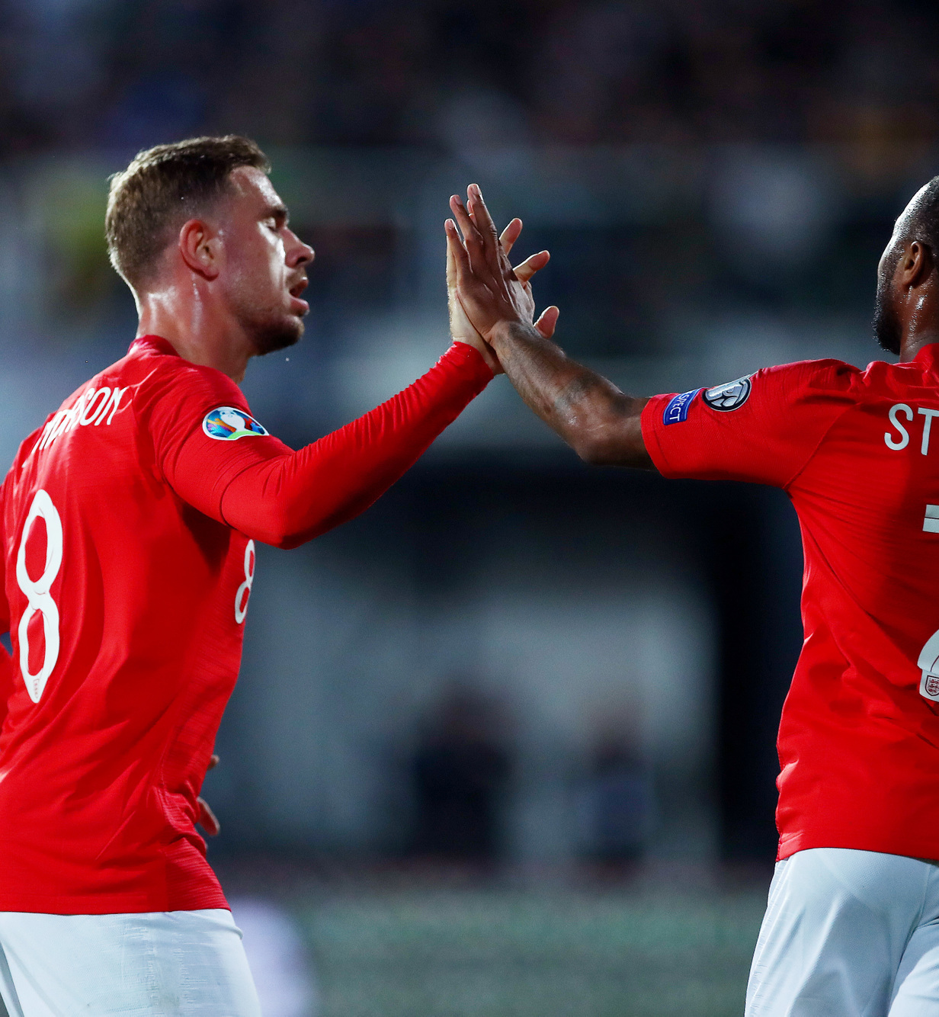
respectful value
Leading by example to inspire positive behaviour
You have been playing a football game against a local school. The other team has been playing very aggressively and have fouled your team multiple times. At the end of the game your team is victorious, normally all players would shake hands, however some of your team suggest you should not. What should you do?
How could you follow The FA PRIDE values and improve the situation?
How could you inspire positive behaviour?
Notes:
Teacher Notes
Help to guide students:
Positive behaviour would be to rise above this and show respect to the other team.
By taking the initiative and beginning to shake hands with the opposition team you are leading by example.

Slide 9
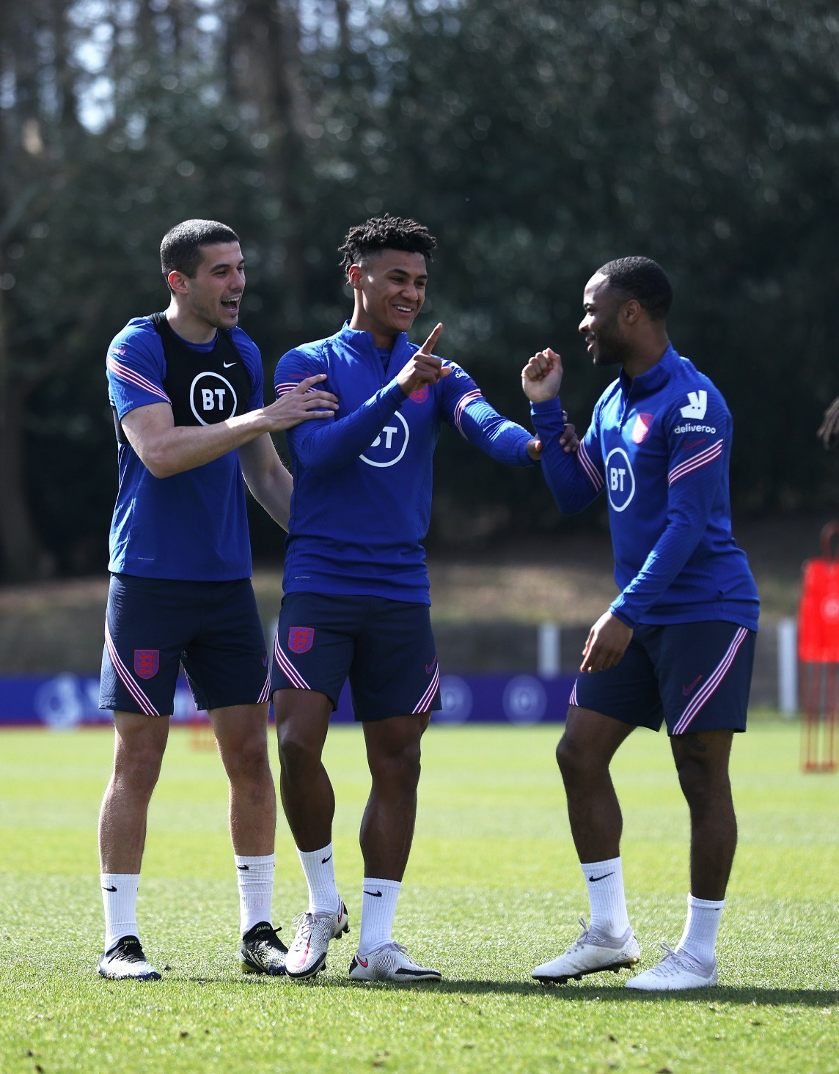
inclusiveness value
Uniting all people of any age, ethnicity and background
You are playing a football game in the playground at school. Boahinmaa has joined the school recently, moving with her family from Ghana. She asks to join in the game. One of the other players says she cannot, as she is not from around here.
How could you follow The FA PRIDE values and improve the situation?
How could you inspire your friends to be more inclusive?
Notes:
Teacher Notes
Help to guide students:
Inclusivity should be at the heart of any football game and in society.
Standing up to and challenging the other pupil’s comment helps to promote inclusivity and let others know it is not acceptable.

Slide 10
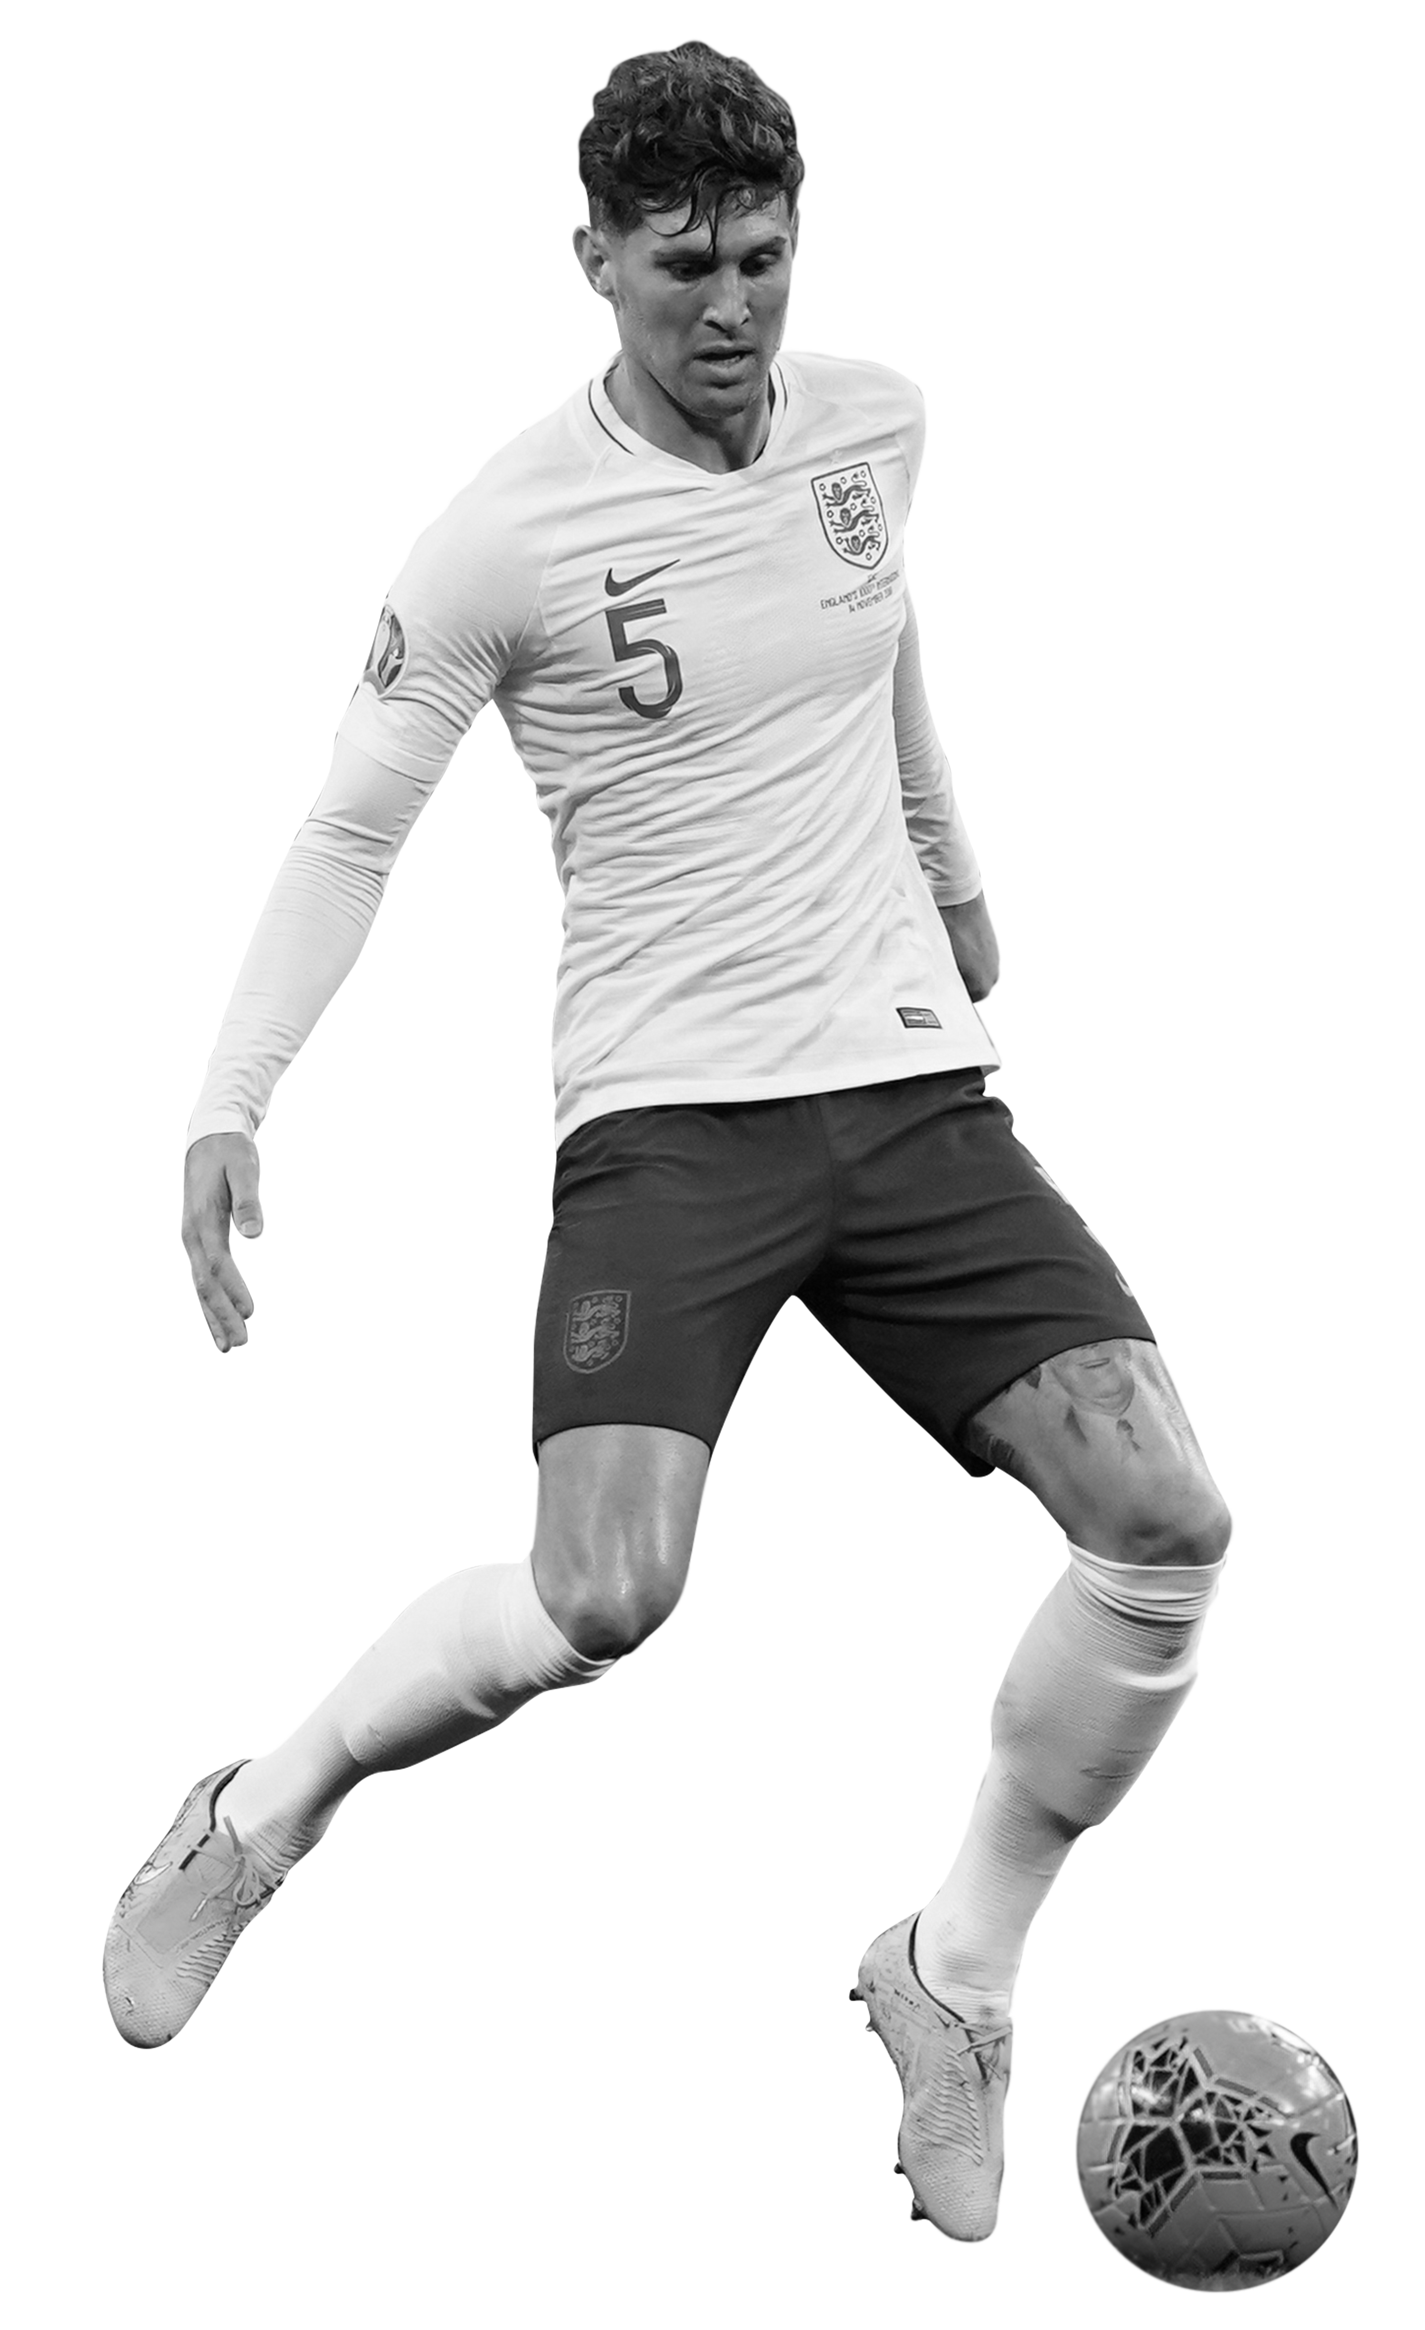
determined value
Rising to and overcoming challenges
You are a striker for your school football team. Recently you are struggling to hit the target and score goals. Your attitude is becoming very negative and you are feeling disappointed with yourself. Your team has the support of a coach and you have many friends in the team.
How could you follow The FA PRIDE values and improve the situation?
Who could you speak to? What can you do to change the situation?
Notes:
Teacher Notes
Help to guide students:
Speaking to your coach to find ways to improve your striking and your mental outlook.
Speaking to your friends about how you are feeling and asking them for help.
Talking to whoever is at home and being honest about your feelings to gain reassurance and help.

Slide 11
excellent value
Striving to make football the best it can be
Discuss in your pair a situation where you have made it the best it can be, this can be in football or anywhere in your life.
If you can’t think of one, what situation could you improve in the future or what could you have done in the past to embrace The FA PRIDE values.
Notes:
Teacher Notes
Help to guide students:
Even when things go well, there may be room for improvement or lessons that can be learnt.

Slide 12
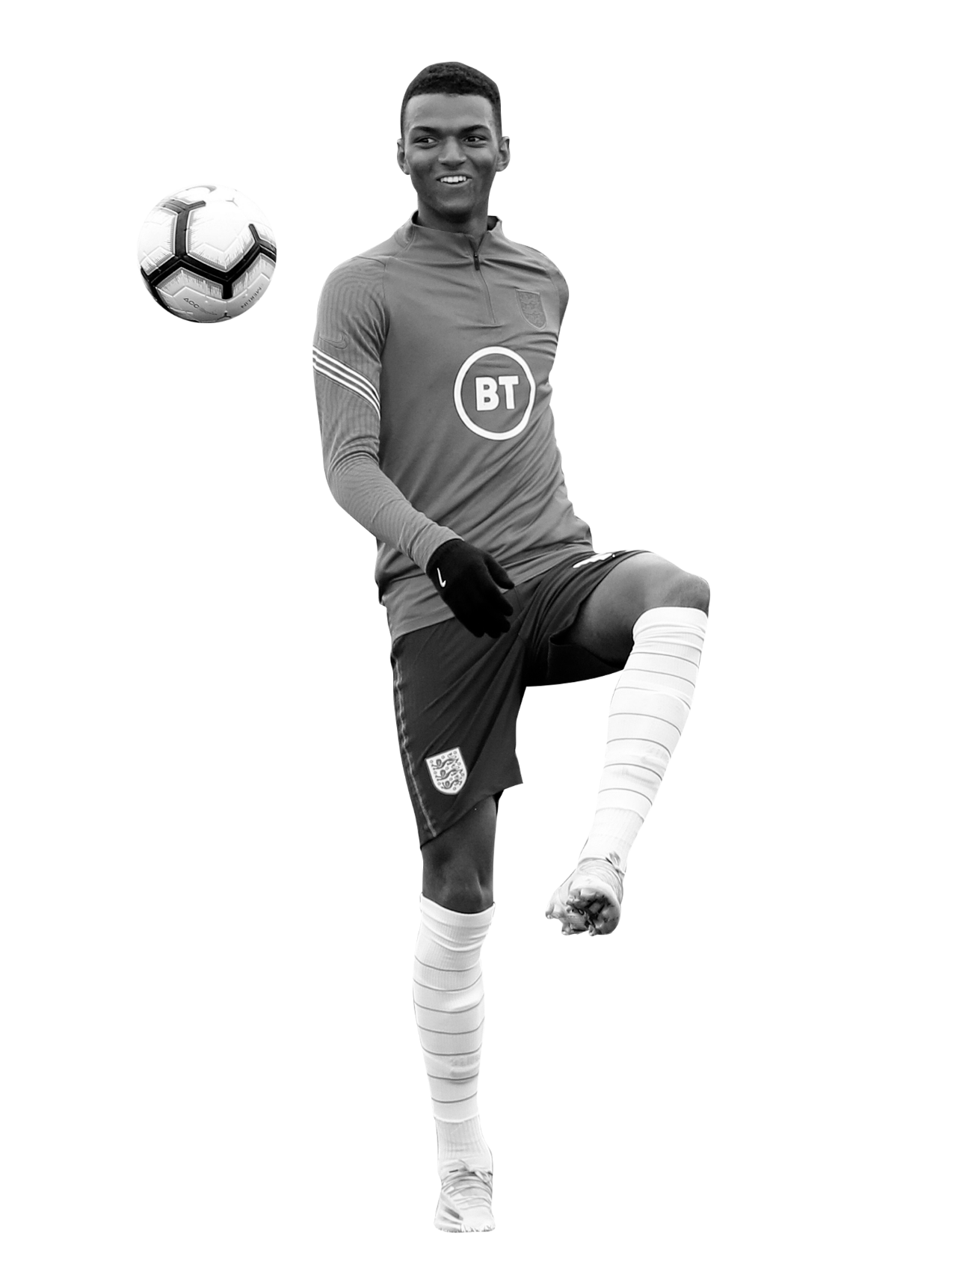
The fa pride values in your school
Use your knowledge and understanding of The FA PRIDE values to make a poster to help students in your school know and understand these values.
What are the values?
What do they mean to you?
Present them so they are noticed by pupils.
Use a football theme to help pupils promote ‘a game for all’.
Notes:
Teacher Notes
Pupils could work in groups to discuss and design a poster.

Slide 13
Let’s write home
What are values and why are they important?
Write a postcard home saying what you have learnt about the key values in football and why they are important.
Can you include:
Answer your big question.
The FA PRIDE values and what they mean.
Why these values are important.
Where are we going next?…..
Notes:
Teacher Notes
Students to consolidate their learning within this section.
Linking back to the big question.

