Slide 1
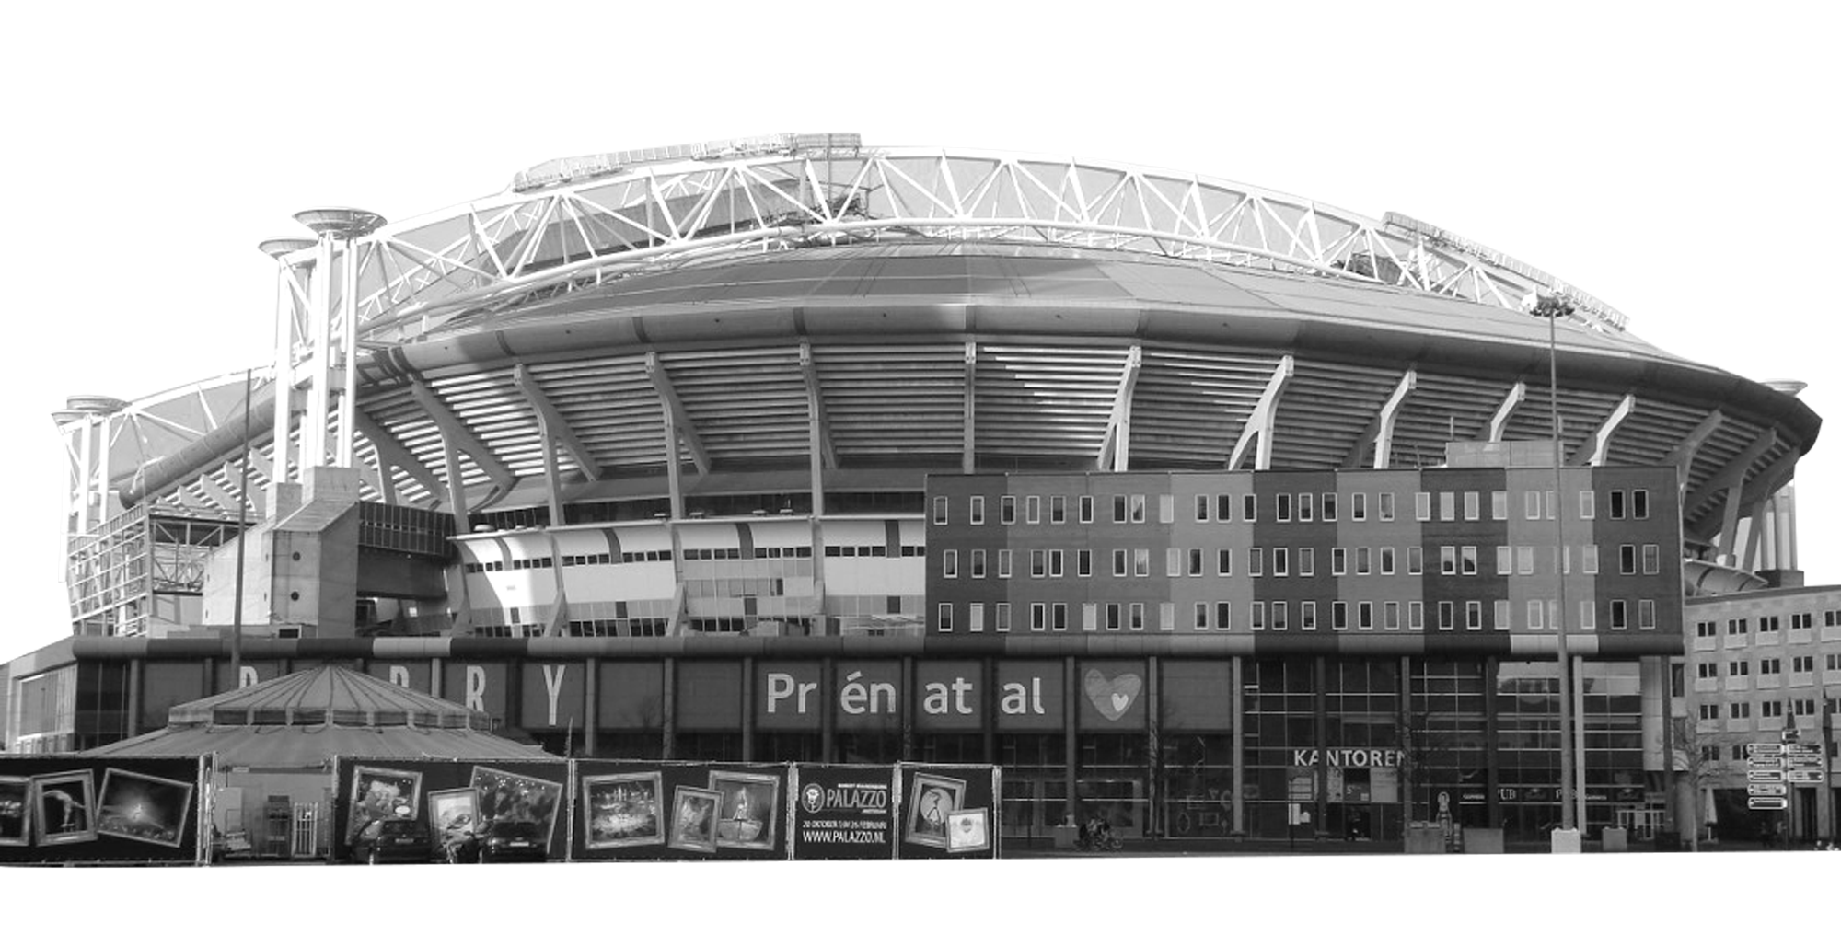
Welcome to..
AMSTERDAM
Continent: Europe
Country: Netherlands
Capital: Amsterdam
Jordaan district
What country is the Netherlands next to?
What is the official language of the Netherlands?
Johan Cruijff Arena
Notes:
Teacher Notes
Starter activity: Get students thinking about what country they are visiting.

Slide 2
WELCOME TO AMSTERDAM
You’ve made your railway journey to the capital city of the Netherlands. It is famous for its canals, tulips and cheese. It is one of the Group C hosts in UEFA EURO 2020.
What teams will be playing in this group?
Use the flags below to find out…
Amsterdam
Netherlands
Ukraine
GROUP c
Austria
North Macedonia
Notes:
Teacher Notes
Brief introduction to Amsterdam as a city.
Locate the Netherlands and then Amsterdam on the map.
Use the Amsterdam Host City Guide to discuss the country in more detail (optional).

Slide 3
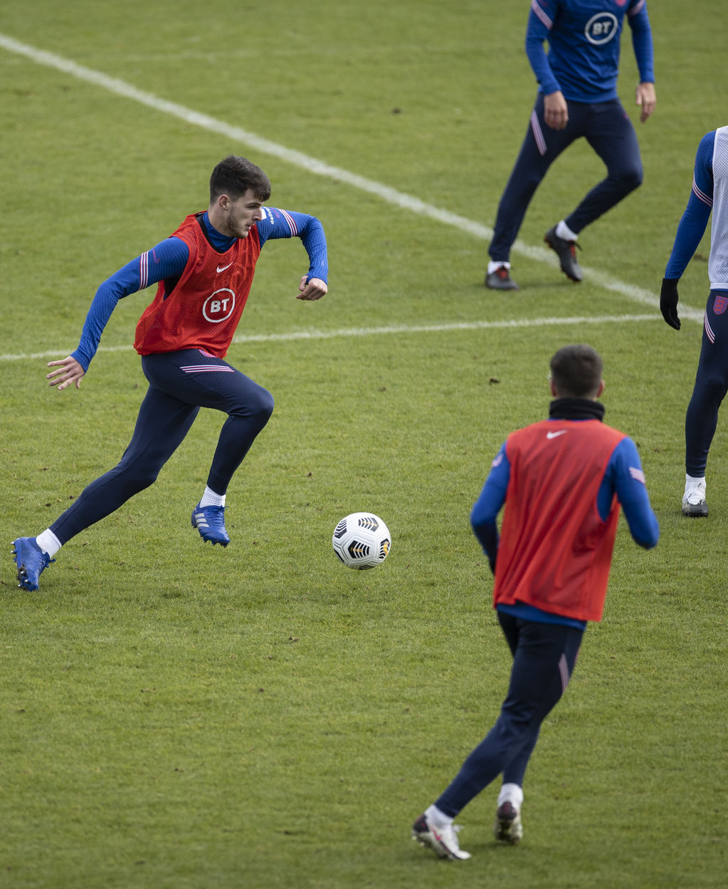
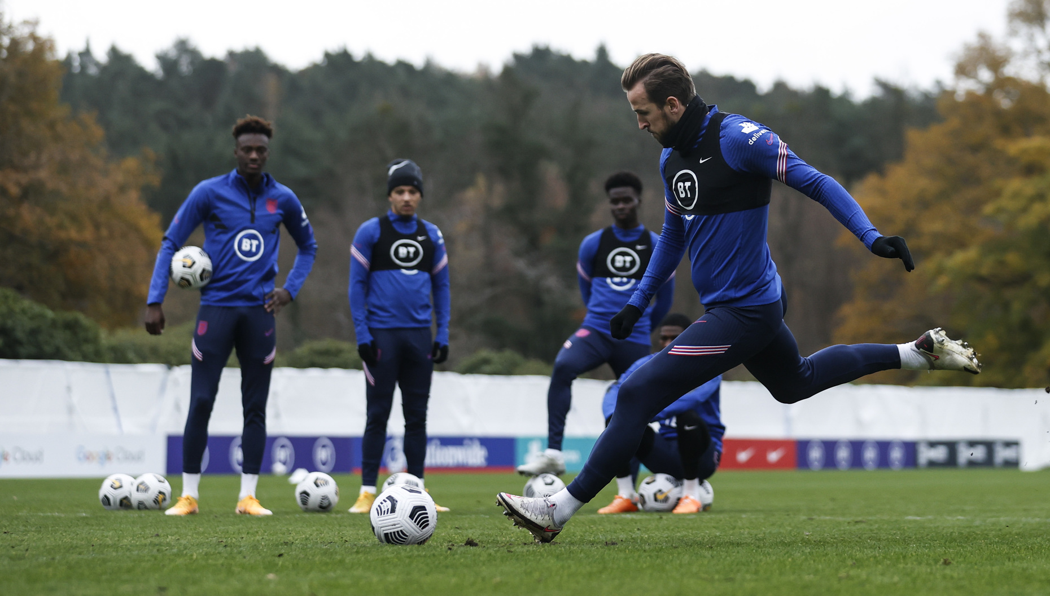
YOUR BIG QUESTION TO ANSWER IN AMSTERDAM IS:
In Amsterdam we are going to use maths skills to look at how footballers use angles to improve their game.
How do I get the football into the net?
Learning objectives:
To be able to identify, group and measure basic angles.
Identify 0º, 45º , 90º and 180º.
Measure angles using a protractor.
Group angles into acute, obtuse and right angles.
Notes:
Teacher Notes
The big question to answer is a key point of the lesson.

Slide 4
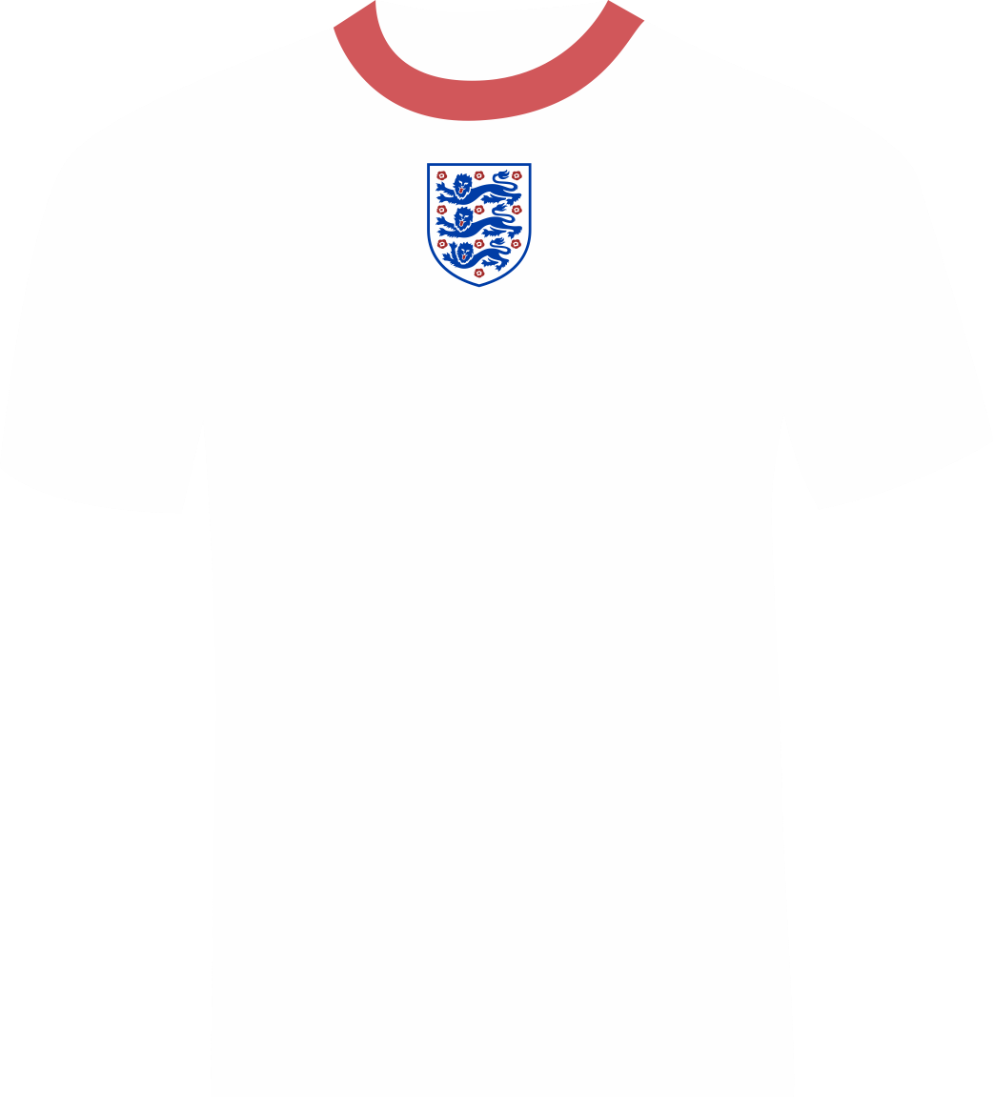
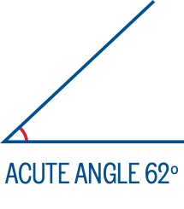
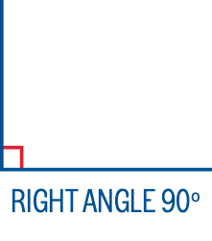
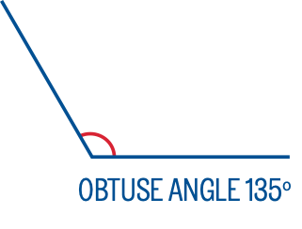
WHERE ARE ANGLES USED IN FOOTBALL?
Think, Pair, Share
How many ways can you think of that angles are used in football?
Notes:
Teacher Notes
This question is to get students thinking of a football match setting.
Students should have 30 seconds to think quietly.
The teacher should find out from the class their thoughts.
Angles are used in numerous situations.
Passing (choosing angle to pass ball and moving player position to receive pass).
Shooting (what angle to hit the target, what angle to not hit the goal keeper).
Football pitch lines (90 degrees around the pitch where lines meet).
Corners taken from a 90 degree angle.

Slide 5
HOW DO FOOTBALLERS USE ANGLES?
Notes:
Teacher Notes
Play the video to:
Help students see how angles are used in football.
Gain the knowledge from a real footballer.

Slide 6
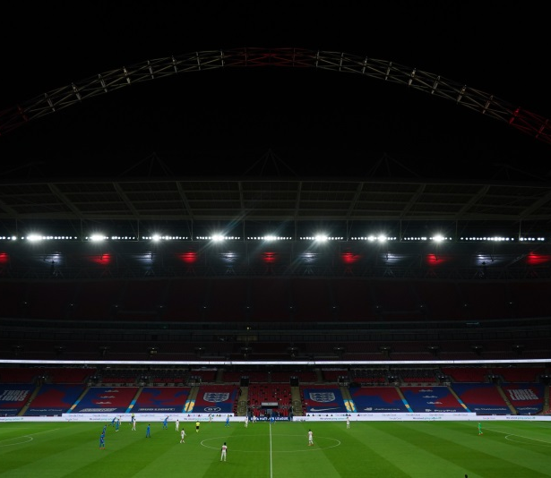
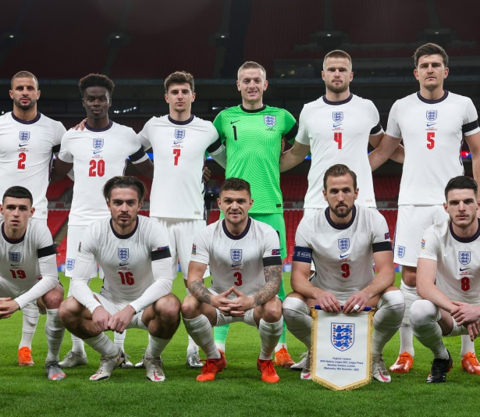
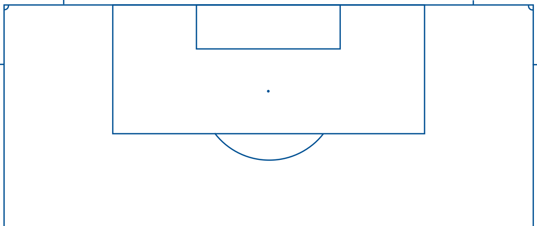
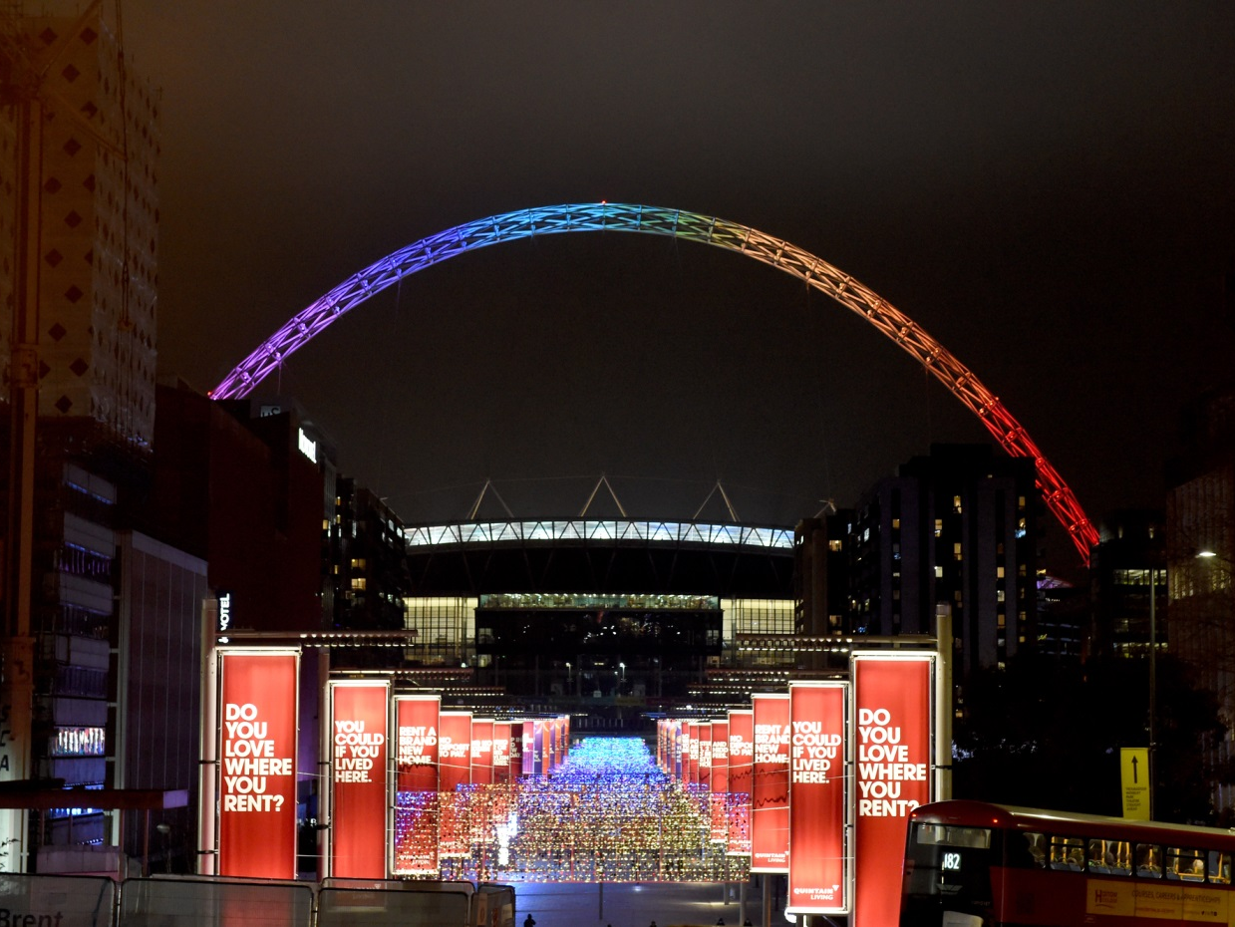
TASK:
Find all the examples of angles you can around the football pitch.
Notes:
Teacher Notes
This task’s aim is to challenge students to recall their knowledge of angles with size, correct labelling and acute, obtuse and right angles identified.
It can be completed using Activity 1 on the Measuring Angles worksheet as an independent task.
It can be used for front of the class questioning, with the teacher drawing onto the interactive white board or projected whiteboard with the students answers and ideas.

Slide 7
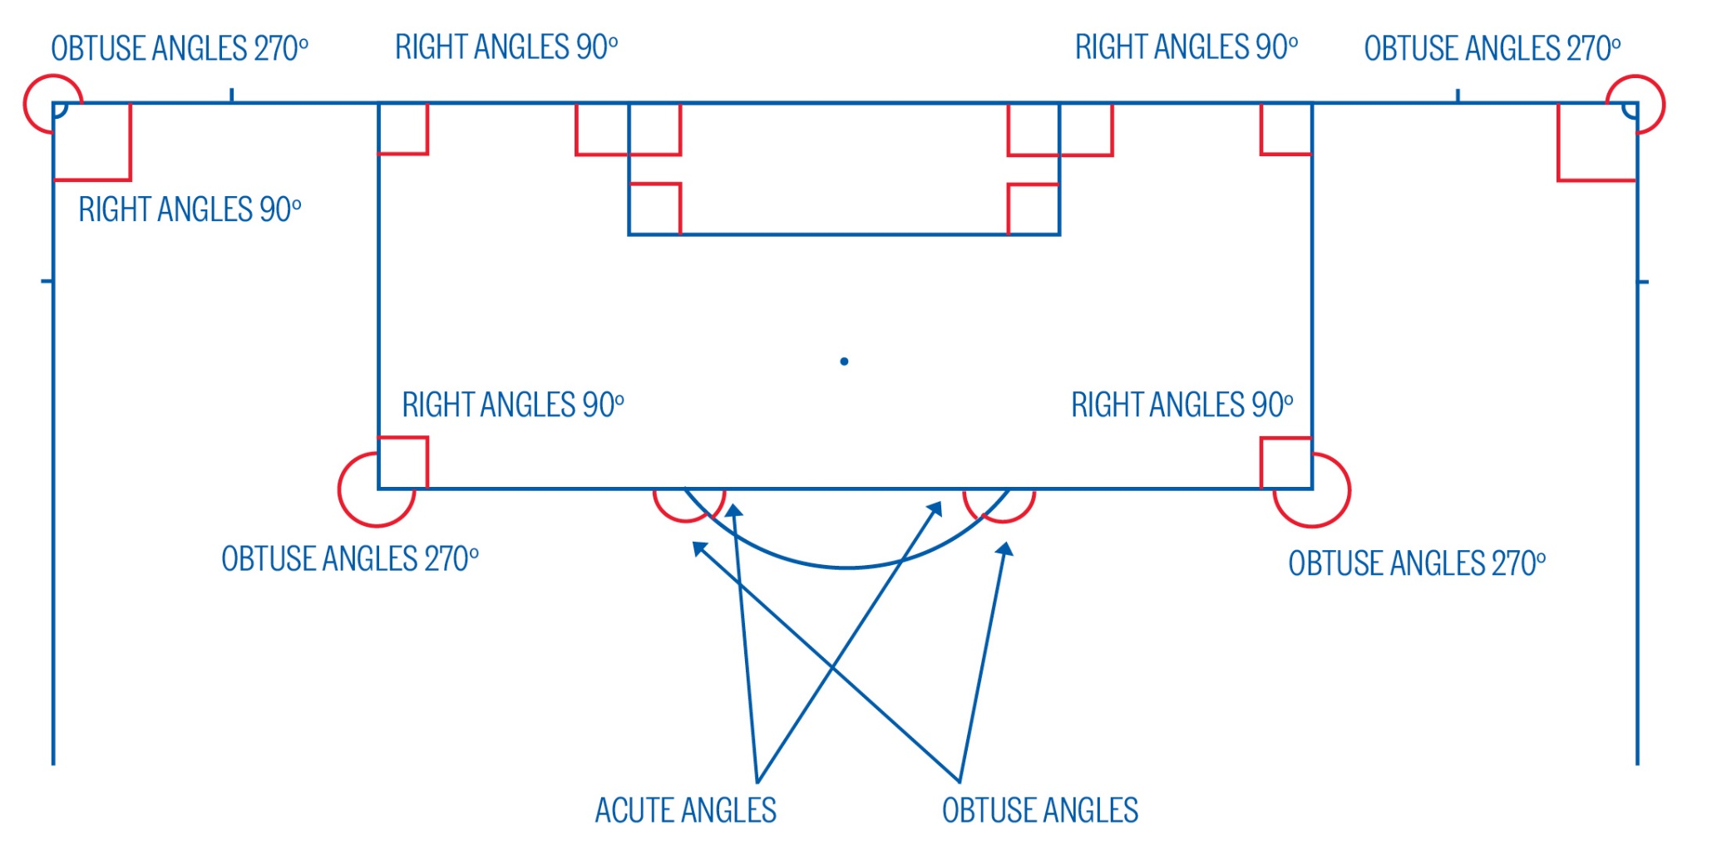
SOLUTION:
Notes:
Teacher Notes
Discuss the answers, highlighting various acute, obtuse and right angles in the diagram.

Slide 8
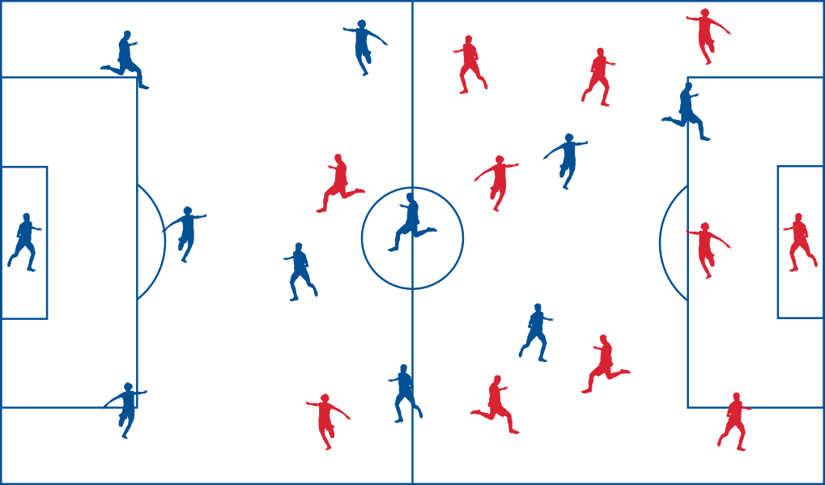
TASK:
Using your knowledge of angles, help the England team plan their passing and shooting tactics.
You will do this by:
Identifying 0º, 45º , 90º and 180º angles.
Measuring the angles the players use with a protractor.
Identify angles as acute, obtuse or right angles.
Planning your own route to goal using angles.
Notes:
Teacher Notes
Task is aiming to use knowledge of angles to look at how footballers use angles in passing and shooting.
Students can complete Activities 2 – 5 on the Measuring Angles worksheet as an independent task.

Slide 9
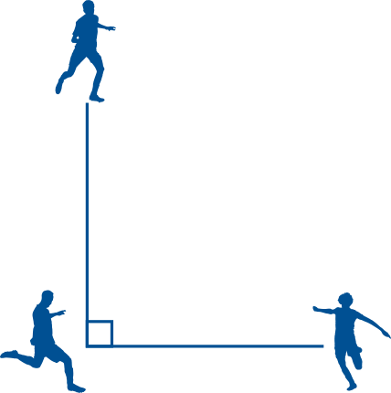
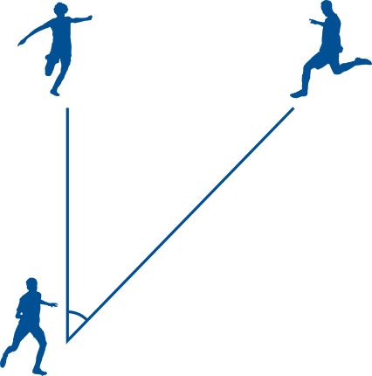
TASK:
Angles in practice with football skills.
Now it’s time to put your angles knowledge into practice with some football passing skills.
Your teacher will call out what pass you need to make.
90º PASS
45º PASS
0º PASS
Notes:
Teacher Notes
This activity needs:
1x football per group. (Extension of adding another ball if equipment permits).
Students in groups of 4.
Marks or cones on the floor may help students maintain placement.
Can be completed indoors if poor weather using a ball to throw instead of kick. Or in indoor hall with standard equipment.
Teacher demonstrates the task.
Students stand in square shape at each corner.
Teacher calls out what angles the students need to pass the ball.
To assist with group control it may help to blow a whistle when students should pass.
The expected angles and passes are shown above.
Can hand over angle responsibility and speed of passing to students in the group to allow independent work.
6. To extend task difficulty:
Add in a second ball to each group.
Increase rapidity of changes of angles.
Increase rapidity of passes made.
Stop the activity and get students to answer questions on the type of angles they are passing around.
Which angles are right and acute?
How could you show a 180 degree angle?
When you pass all the way around the square what is the total angle passed through?

Slide 10
LET’S WRITE HOME
How do I get the football into the net?
Write a postcard home saying what you have learnt about how footballers use angles during a match.
Can you include:
What angles there are on a football pitch.
How footballers use angles to pass the ball.
How you used angles in your football game.
Where to next…..
Notes:
Teacher Notes
Students to consolidate their learning within this section.
Link back to the big question.

