Slide 1
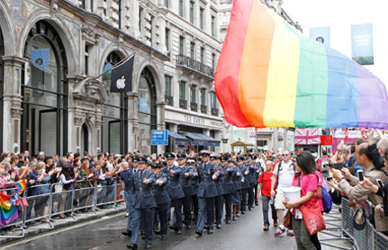
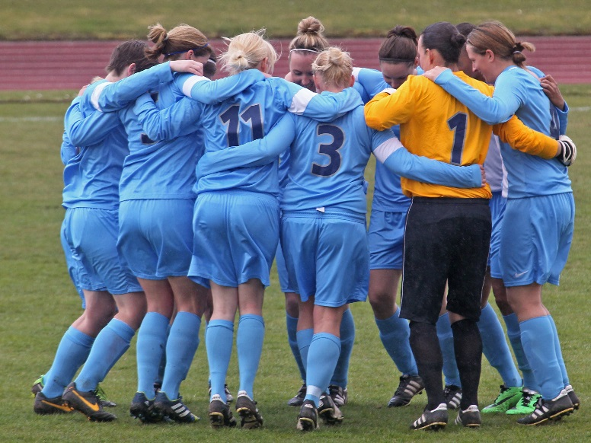
Equality statement:
The RAF FA is committed to promoting and developing equality and diversity in all its activities and for everyone involved with RAF Football, irrespective of race, gender, gender reassignment, marriage or civil partnership, pregnancy and maternity, disability, religion, sexual orientation, age or socio-economic circumstances.
Support Sources/Networks:
Station Equality & Diversity Advisor (EDA)
Padre / Chaplain – details of Muslim/Hindu/Buddhist/Jewish/Sikh Chaplains, call SO2 D&I Policy 95221 5462
SSAFA
Citizens Advice Bureau (www.citizensadvice.org.uk)
Stonewall (www.stonewall.org.uk)
Transgender: The Gender Trust (www.gendertrust.org.uk)
Legal Services Commission (www.legalservices.gov.uk)
Army Servicewomen’s Network (Army-Servicewomen-0Mailbox@mod.uk
Army LGBT (www.armylgbt.org.uk)
RAF D&I Portal
Navy D&I Portal
Army D&I Portal
Civilians in Air
Service Complaints Ombudsman
Defence Disability Network
Defence Stammering Network
MOD Dyslexia Network
MOD LGBT Network
Ethnic Minority Steering Committee (EMSC)
Policy:
Equality Act 2010 (www.equalities.gov.uk/equalities_act_2010)
AP 3392, Vol 5, Leaflet 109 (accessed through the Defence Intranet)
JSP 887 109 (accessed through the Defence Intranet)
JSP 913 Tri-Service Policy on Domestic Abuse and Sexual Violence

Slide 2
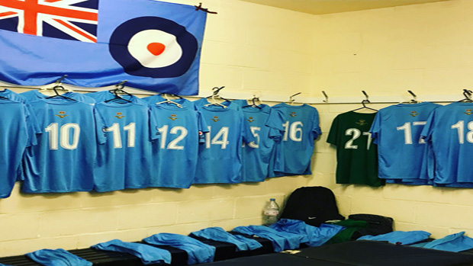
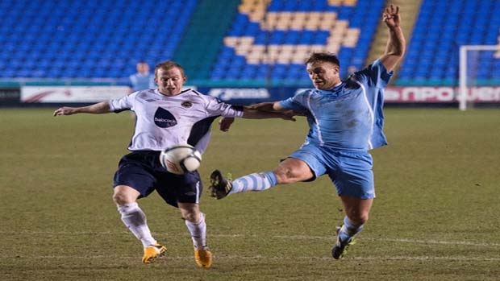
RAF FA Diversity & Inclusion Statement:
Air Cdre Rich Pratley, Chairman RAF FA
Vision
As the Chairman of the RAF FA, I am responsible for ensuring that everyone involved with RAF Football is aware of, and complies with, the MOD and RAF D&I policies and directives. I consider the basic tenet that all personnel deserve to be treated with respect and dignity to be at the heart of what we do. All personnel have a direct liability to comply with equalities legislation and with D&I law. The RAF FA directive is based on the following 3 principal tenets of D&I:
Leadership, Knowledge and Confidence
Leadership
I expect all personnel involved with RAF Football to treat everyone, both military and civilian, fairly, with dignity and respect. Our behaviour to one another must reflect best practice and encompass the aims and goals of the RAF. The promotion of D&I is an essential element of good leadership and management, and crucial to enhancing team cohesion and effectiveness. We must embrace the diversity of our personnel and use individuals’ different experiences and backgrounds to our advantage.
Valuing Difference:
The RAF FA is an inclusive association which supports and values difference at all levels. The Equality Act 2010 sets out the legal protection in place for personnel who fall into the following 9 Protected Characteristics:
You may not consider that you fall into any of the
Protected Characteristics but most people fit into
one, forming part of a diverse organisation. As part of the MOD’s commitment to its people the RAF FA want to ensure that everyone has the help and support they need to enjoy the game.
Knowledge
I expect Football leaders at all levels to take full responsibility to ensure that attitudes are challenged and unacceptable behaviour is eradicated. Training and education is critical to the success of our D&I directive. Individuals are therefore to take personal responsibility for completing their mandatory RAF D&I training. Furthermore, leaders are to ensure that all staff are aware of the Service’s Core Values and Standards and who their respective unit Equality and Diversity & Inclusion Advisor (EDIA) is.
The RAF FA lead for D&I is Wg Cdr Louise Hancock (louise.hancock906@mod.gov.uk) and any general queries on D&I policy should be addressed to her.
Confidence
All personnel involved with RAF Football have the right to be treated fairly in an environment free from harassment, intimidation, prejudice or malice. I expect Football leaders to create a positive climate whereby individuals have the confidence to speak out if they hear or see any inappropriate behaviour. They must instil a culture to allow their subordinates to provide feedback and constructive comment or criticism. Such confidence will be created out of knowledge of policy and, more importantly, of our values and standards and how they are relevant in all that we do. All personnel involved with RAF Football must be reassured that should they wish to report inappropriate behaviour that they will be taken seriously, dealt with in a timely manner and treated in confidence.
If you would like more information on getting involved with the RAF FA please contact:
Mr Vince Williams
County Secretary RAF FA
RAF Brize Norton
www.royalairforcefa.com
(GPTN) 95461 5704
/ 01993 895704

