Slide 1
NORTHUMBERLAND FOOTBALL ASSOCIATION LIMITED
Creative Game & Practice Design
Adam Colley – FA Coach Developer
Monday 17th January 2022
7pm – 8pm

Slide 2
Good evening!
This is me!

Slide 3
The Classics!
What are the go-to conditions that you and other coaches tend to use when playing games in training?

Slide 4
The Pay-offs
What are the outcomes of these rule changes?
Do they meet the outcomes of your session?
Rule Change | Tactical Outcomes | Technical Outcomes
3 touch | ??? | ???
Every player must touch the ball before scoring | ??? | ???
Left footed goals only | ??? | ???
Are these conditions realistic to the game?

Slide 5
How might you get “Extras”???
Not all of your players will able to do the Classics, so how might you create conditions that tap in to other aspects of the game?
What Social aspects could you include and how?
How might you gain a Psychological understanding of your players?
What conditions might affect them in the Physical corner?
Gamification - “the application of typical elements of game playing (e.g. point scoring, competition with others, rules of play) to other areas of activity”

Slide 6
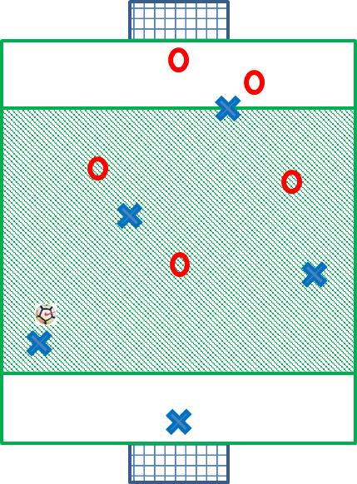
“No Going Back!”
Game Related Practice
When in the central zone, the player in possession can only make a forward pass.
In either of the end zones, the ball can be passed forwards, backwards or sideways.
A free-kick is awarded should a pass in the central zone not go forwards.
The rule applies to both teams.
Q: What might be your session aim/outcome for this GRP to be part of it?
Dribbling
Passing
Shooting

Slide 7
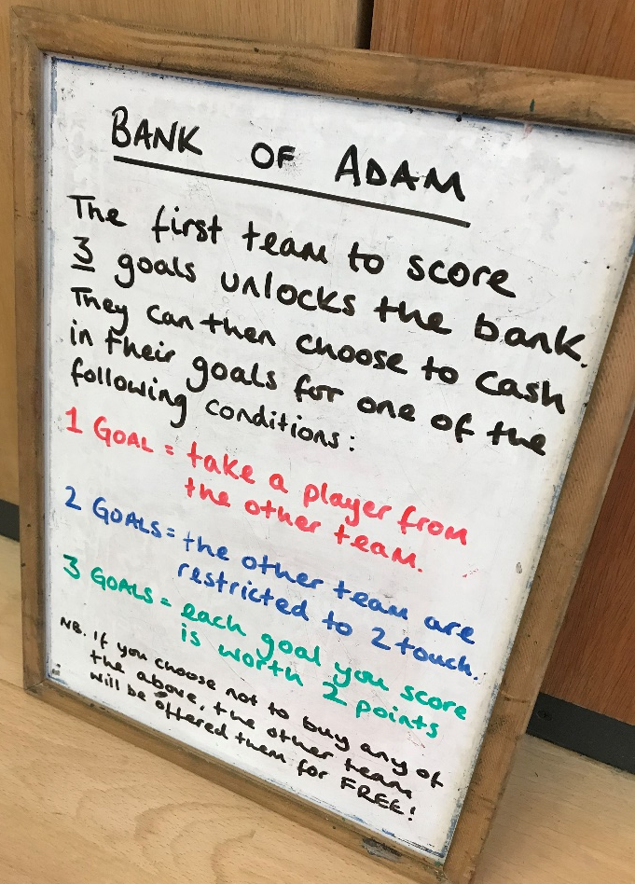
“The Bank of Adam!”
Game Related Practice
Psychological Outcomes:
- will players go out to score 3 goals ASAP?
- does the other team’s goal total change the
choice?
- after that choice, which team will affect?
Q: How might you include additional Player Ownership in to this practice?

Slide 8
“Football Bingo!”
Right Foot
Volley
Game Related Practice
Each team has 4 – 6 methods of scoring
Each time that method is achieved, the goal scorer must go directly to their team’s Bingo card and cross it out.
The opposition can re-start play from the goalkeeper as quickly as possible
Q: What would this condition give players the chance to take advantage of?
Header
Left Foot
First Time Finish
GK scores!
Overloads
Creativity
Both

Slide 9
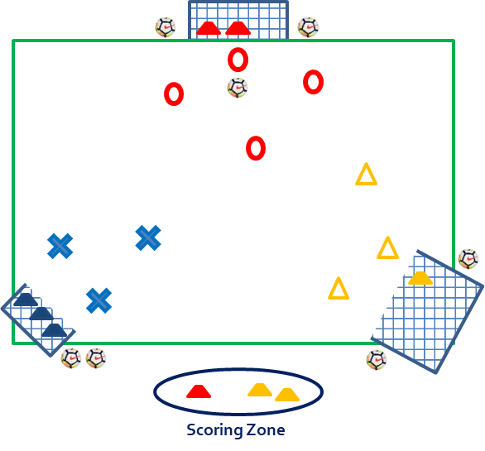
“The 3-goal Game!”
Game Related Practice
3 teams of the same or different number of players (no more than 5)
With 1 ball in play, teams must attempt to score in either of the other team’s goals
When they score, any team member must collect a cone from their goal and place it in the Scoring Zone
The first team to get 3 cones in the zone or the team with the most after 3 mins wins!
Progression: Each team starts with 6 cones. They come up with a unique way of scoring and if successful, they place 3 cones in the zone
The first team to get 6 cones in the zone or the team with the most after 3 mins wins!

Slide 10
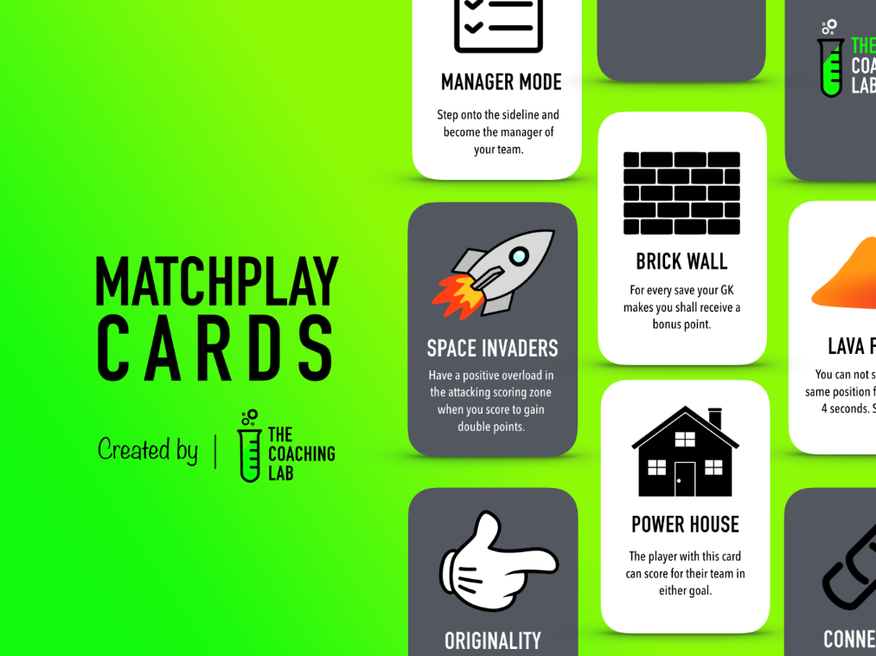
Match Play Cards
Promote thinkers, create challenge, provide support and unleash creativity
Supporting coaches to deliver sessions that are representative of the game's demands
Asking players to make in-game decisions and problem-solve
thecoachinglab.org

Slide 11
In summary…
Be Creative
Allow players to be creative too!
Give players choice
Allow players to problem solve
Provide them with challenges that aren’t just technical
Create competition
Enjoy it!

Slide 12
Thank you!
Adam Colley
adam.colley@icloud.com
07765406268
@adamski110

Slide 13
NORTHUMBERLAND FOOTBALL ASSOCIATION LIMITED
THANK YOU!
QUESTIONS?

