Slide 1
Resolving Parental Conflict
Ben Pearce
Designated Safeguarding Officer
ben.pearce@lincolnshirefa.com
@LincsFADSO

Slide 2
Current Common Issues
Foul & abusive (and often aggressive) language towards match officials & club officials
Shouting things that incite conflict and/or are detrimental to coach instruction
Being present in areas that are not designated for parent spectators
Videoing whole games or parts of games without the appropriate consent
Resolving Parental Conflict

Slide 3
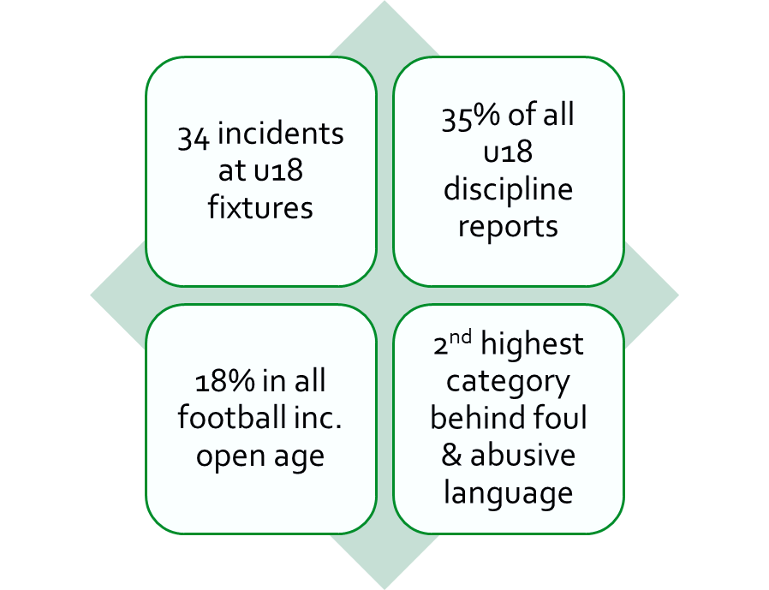
Current Discipline Statistics
Lincolnshire wide
2023/24 season so far
Category: Failure to control players/spectators
Resolving Parental Conflict

Slide 4
Most Effective Solution: Club Culture
Welfare & Safeguarding are everyone's responsibility
Conduct of the coaches is critical
Can only embed a strong culture with a supportive committee
When necessary, action is:
Clear
Decisive
Rational
Recent tip from an SV:
Have your respect line further back from the touchline
Resolving Parental Conflict

Slide 5
The importance of Codes of Conduct
Best Practice
All parents sign and return Codes of Conduct prior to the start of the season
Codes of Conduct are visible around the club
https://blythtownfc.com/club-documents/
Supporting Policies (Important)
Participation Policy
Anti-Bullying Policy
Complaints Procedure
Social Media Policy (can be within code of conduct)
Club Code of Conduct Checklist
Clarity on what is acceptable
Clarity on what is not acceptable
Reference to language and behaviour
Link to club values
Clarity on what may happen
Progressive outcomes
If you are reminding parents of, or re-sending to parents, your codes of conduct – give them the context around this, rather than just ‘sending out'
Resolving Parental Conflict

Slide 6
Importance of record keeping
Always try and keep a record of raised concerns
You could invest in software to do this (particularly if you are a large club), otherwise an organized record log on excel, google docs MS forms, supports easy record keeping
This supports managing conflict with parents who have been a concern previously
Just ensure that agreed personnel keep the appropriate records with the agreed data secure (behind passwords/locked sheets etc)
Resolving Parental Conflict

Slide 7
Dealing with issues & conflict
Have agreed personnel on the committee to be the main communicators
Normally CWO, Chairperson or Secretary
Reference this in your complaint's procedure
Try to ascertain context by speaking to people rather than email or message
Be transparent about what the problem is
Follow up conversations with email
If you are meeting to formalize action, always have at least one other person there
You need the coach (if not implicated) to remain impartial and maintain neutrality on any matters
Resolving Parental Conflict

Slide 8
Example
Parent is persistently using poor language whilst spectating and is confrontational when challenged about it. Despite previous warnings and opportunities to rectify their conduct – they refuse to do so.
Side Note:
Letting go of players
Be careful!
Is it the child’s fault?
You can still enforce action against the parent and keep the child playing football.
The parent will still have a right to drop off and collect child
Both of these are within your constitutional rights
Safeguarding Awareness for Parents & Carers is free & available
-Key officials meet to agree action
-Action is clear and formal
-If banning, have a time frame
-Ask parent to complete online learning
Resolving Parental Conflict

Slide 9
Video Content of Children
Videoing the game | Videoing confrontation
Often without malice or intention However, consent is key There are more frequent examples of children’s identity needing to be protected It is not best practice to post footage of games when other children are identifiable on any social media platform, when consent has not been provided | Although it can provide context and be used as an evidence base for discipline….. It is not best practice We would rather people focus on de-escalating the tension, than deciding to get a phone out and start recording There is a current referee body cam pilot project, that is being extended to more areas
The Law:
It is not against the law to take a video or photograph in a public place
You have more power if you play at a private ground
If you play on public land, you can still have codes around media (such as in your parent code of conduct)
Resolving Parental Conflict

Slide 10
CONTACT US
T 03449670708
Lincolnshire Football Association Ltd Deepdale Enterprise Park Deepdale Lane Nettleham Lincoln LN2 2LL
Resolving Parental Conflict

