Slide 1
Roles and Responsibilities of the Respect Steward by Ian Binks Hampshire FA Designated Safeguarding & Lead Respect Officer

Slide 2
Respect Steward
It shall be the responsibility of every U7/U8/U9/U10/U11 and U12 teams Affiliated with a Youth Football League through Hampshire FA to provide a match Respect Steward (RS) for their football fixtures commencing Season 2018-19.

Slide 3
Who should carry out the role?
Ideally Not the Manager or Coaching Staff.
An Adult who preferably is someone that is calm but confident in dealing with others within their own Club.
Try to keep the same person every week or a small group of people to carry out the role on a rotational basis.
Make sure they are known to supporters of your team.

Slide 4
Appropriate Attire for Club Respect Steward
Do I have to wear a fluorescent jacket?

Slide 5
Visibility
Easier for the Referee to identify the Match
Respect Steward in this group of people?

Slide 6
Prior to the game each Respect Steward (RS) shall introduce themselves to the Referee and make them feel welcome. Home (RS) direct them to their changing rooms if applicable and offer a drink if facility available. Ensure their fees are paid and escort them accordingly if required as they leave the venue.

Slide 7
Responsibilities
Ensuring that their own spectators comply with Respect designated spectator area.
Remind own supporters of responsibilities in relation to Respect.
Support the Referee when dealing with any spectator related issue within your own team.
Use common sense and at all times be a visual point of contact for any concerns from the opposition (RS).
Dependent on League procedures the (RS) may assist to check registration cards or complete match result cards.
The FA Respect Programme must be considered by the (RS) at all times, and any issues should be reported to the League & County Association.

Slide 8
Match Respect Steward & Respect
The Match (RS) can help the Club ensure that the Respect Programme is followed for the benefit of all participants. The (RS) should use their own knowledge of their own Club spectators to help prevent abuse, foul language or other unacceptable behaviour. The (RS) should ensure their own safety at all times and if in doubt about the potential for a situation to escalate they should act in accordance with their concerns.

Slide 9
Working collectively Together
We want to work together to avoid this!!

Slide 10
Non Adherence !!!

Slide 11
Compliance
And see
more of this

Slide 12
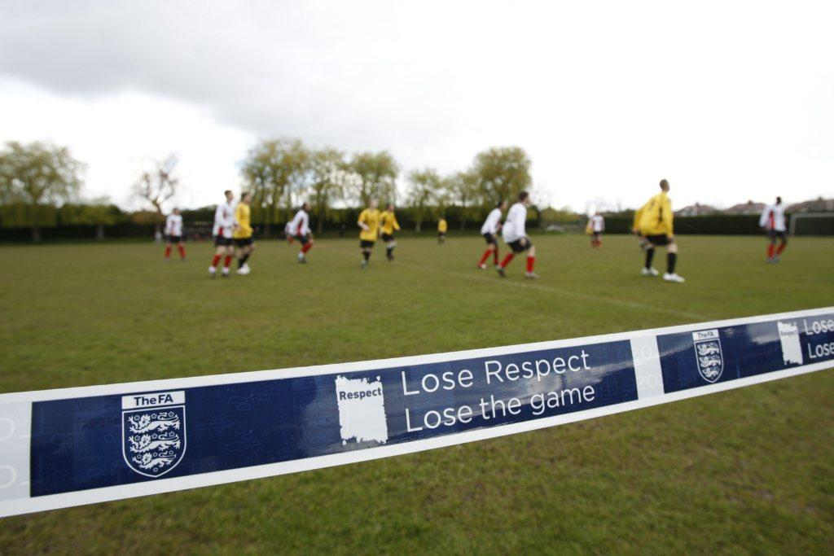
Designated Spectator Areas
Poles with ropes or tape
Cones
Spray paint.

Slide 13
Compliance

Slide 14
Designated spectator areas
Accepted Enhanced Criminal Records Check with the FA via the DBS
Managers, Coaches, Physios/ Medics, Substitutes, Referee Mentor
Assistant Referee
No
Go
Area
No
Go
Area
2 metres
Assistant Referee
Spectators/ Parents/ Guardians

Slide 15
Reporting Concerns
Your Club Welfare Officer
Your League Welfare Officer
Designated Safeguarding Officer: Ian Binks Ian.Binks@HampshireFA.Com
Operations Administrator Safeguarding
Callum.Amos@HampshireFA.Com
HFA Discipline Manager
Discipline@HampshireFA.Com
HFA Referee Development Manager: Andy Moisey
Andy.Moisey@HampshireFA.Com

Slide 16
Additional resources
FA Codes of Conduct.
FA Captain’s Guide.
FA Parents and Carers Guide.
Club Referee and Assistant Referee workshops can be arranged via the HFA Referees Development Officer 01256 853010.

Slide 18
Further questions?
Contact: Hampshire FA Lead Respect Officer Ian Binks: Ian.Binks@HampshireFA.com

