Slide 1
Recreational Football Development Intern | Hampshire FA
INTERNSHIP APPLICATION PACK:
Recreational Football Development Intern

Slide 2
Recreational Football Development Intern | Hampshire FA
WHAT IS IN THIS PACK?
1 Job Advert & Description
2 Application Process
3 Full Role Profile & Person Specification
4 Supporting Information
Hampshire FA Vision, Mission & Values
If you would like to discuss the role further or have any questions on the content of this pack, please contact Glenn.Brailey@HampshireFA.com using the details below:
E: Glenn.Brailey@HampshireFA.com
T: 01256 853 023

Slide 3
Recreational Football Development Intern | Hampshire FA
APPLICATION PROCESS
Please see the accompanying advert & job description, full role profile & person specification and supporting information. These should be used as a guide when completing the application form. The application form can be made available in alternative formats and should this be required please contact us to advise of your requirements.
Please complete the application form by clicking here.
If shortlisted, you will be invited to interview for the role. The exact format of the interview will be confirmed with notice of the interview and reasonable adjustments can be made to accommodate any needs you may have.
Hampshire FA have an understanding and commitment to equality, diversity and inclusion and would be grateful if you could complete an optional, anonymous equality monitoring form as part of your application. By completing this questionnaire, you are helping us to plan for the future and ensure we recruit from a diverse pool of applicants that are appropriate and relevant to the community we serve.
Please complete the equality monitoring form by clicking here.
Hampshire FA are committed to safeguarding children and adults at risk. Due to the nature of this role, the successful candidate will be required to undertake a Disclosure and Barring Service (DBS) check through the FA DBS process. The possession of a criminal record will not necessarily prevent an applicant from obtaining this post, as all cases are judged individually according to the nature of the role and information provided.
Key Dates:
Application Closing date – Friday 28th April
Interview date – 15th, 17th or 23rd May (in person @ Winklebury Football Complex, RG23 8BF)

Slide 4
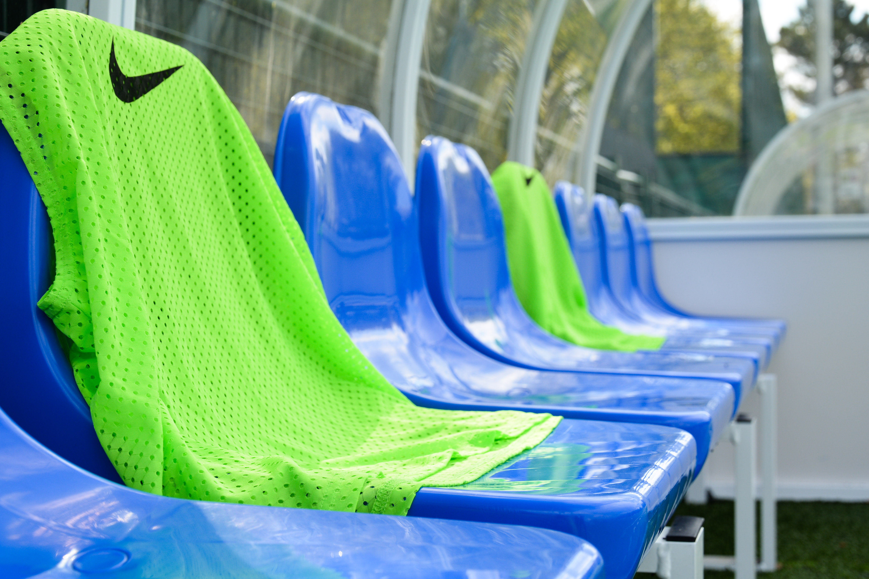
Recreational Football Development Intern | Hampshire FA
Recreational Football Development Intern
Renumeration: Unpaid Placement: FT Sept ‘23 to Sept ‘24
(£100 monthly contribution for travel expenses)
What is the role?
We are looking for someone to drive the development of recreational football across Hampshire, through coordinating the existing recreational league delivery and ‘Just Play’ sessions within the County, whilst assessing opportunities to expand recreational provision in targeted areas for both male and female participants.
What will you do?
You will support the delivery of both the male and female Hampshire FA Play On Leagues, and the Hampshire FA Walking Football League
You will support the delivery of the Hampshire FA Female Futsal League
You will build relationships with existing ‘Just Play’ providers and support the development of new recreational session provision across the County.
You will support with the coordination of recreational disability football across the county
What do you need?
The ability to work collaboratively with a wide range of stakeholders
An understanding of key IT skills required to plan and manage events
The ability to connect and work within local communities
The determination to fail forwards - try > fail > learn > repeat
Applications by Friday 28th April 2023:
To apply, complete the online application form. Interview dates: 15th, 17th, or 23rd May 2023.
Access the form by scanning this QR code with a smartphone:
Or via : https://forms.office.com/e/N64NE7BWLZ

Slide 5
Recreational Football Development Intern | Hampshire FA
FULL ROLE PROFILE & PERSON SPECIFICATION
Hampshire FA are an equal opportunities employer and actively encourage people from diverse backgrounds to apply for all roles.
Role title | Recreational Football Development Intern
Reports to | Recreational Football Development Officer
Role purpose(s) | You will coordinate the delivery of both the male and female Hampshire FA Play On Leagues, and the Hampshire FA Walking Football League You will support the delivery of the Hampshire FA Female Futsal League You will build relationships with existing ‘Just Play’ providers and support the development of new recreational session provision across the County You will support with the coordination of recreational disability football across the county
Location | Winklebury Football Complex, Basingstoke, RG23 8BF Hybrid Working Policy currently in operation providing a mix of office days/remote working (requirement to work in the office two days per week, including a Thursday)
Working hours | Full time - 38.75 hours a week with occasional evening/weekend work required (flexible options available e.g. job share)
Placement type | Fixed term placement from 4th September 2023 – 1st September 2024
Roles & Responsibilities:
Representing Hampshire FA | Actively deliver against Company Values and Behaviours and the Customer Charter Actively support the challenging of all forms of discrimination in football
Retain Participation | Support the existing delivery of recreational football across the county (Just Play) Coordinate existing Hampshire FA recreational league provision, and support players/ teams wishing to transition into competitive leagues Support with coordinating recreational disability football provision in Hampshire
Grow Participation | Use national and local data, research and customer insight to asses opportunities to expand recreational provision Replicate existing recreational provision in to other areas of the county which have ‘cold spots’ in participation Support the expansion of the Hampshire FA Play On League franchise to provide recreational football for open aged players countywide
Stakeholder Engagement | Support existing recreational sessions and leagues in the county Work with partner organisations & clubs to create new recreational football sessions
People | Support the Coaching & Workforce Football Development Officer to recruit, retain and develop coaches from recreational backgrounds, with focus on those from historically under represented groups. Coordinate a number of volunteers/ casual contract staff members to deliver recreational leagues across the county
Safeguarding | Support maintenance of FA safeguarding 365 operating standards and ensure that the safeguarding of young and vulnerable people is prioritised at all times Carry out appropriate Safeguarding Risk Assessments for any activities delivered
Equality, Diversity & Inclusion | Ensure that recreational football is inclusive, diverse and reflective of local communities Use national and local data, research and customer insight to diversify participation in recreational football
Finance | Support Recreational Football Development Officer in budget management for existing and new recreational sessions

Slide 6
Recreational Football Development Intern | Hampshire FA
 | Skills | Knowledge/Experience
Essential (Required to fulfil role) | Ability to plan, set and achieve objectives to deadlines IT skills, including the use of Microsoft Office applications Ability to work independently and as part of a team Time management and prioritisation Problem-solving and decision-making Communication and presentation skills | Passionate about male football Basic understanding of sport/ football development University placement student
Non-Essential (Beneficial but can be accumulated once in the role) | Skilled in creating, delivering and maintaining pathways which support the growth, transition and retention of players. Budget management Ability to use data to monitor and evaluate programmes Ability to work strategically with partner organisations | Skilled in league and tournament delivery Understanding of Football provision in Hampshire
HFA Values | Expected Behaviours
PROGRESSIVE | Identifies the need for, and actions change in direction, practice, policy or procedure. Questions the way things are done and takes informed risks. Continuously seeks to improve efficiency and performance.
RESPECTFUL | Maintains people’s self-esteem when interacting with them. Avoids pre-judgement when listening to suggestions from others. Seizes the opportunity to apply Hampshire FA standards at all times.
INCLUSIVE | Openly collaborates with colleagues and partners in the game Provides equal opportunity to people of different backgrounds, experience and perspective Seeks out and embraces new ways of thinking and working.
DETERMINED | Works relentlessly to overcome roadblocks or obstacles to achieve the goal. Remains focused on seeing agreed goals through to completion taking pride in their work. Maintains motivation for their team and themselves.
EXCELLENT | Seeks to achieve the highest levels of performance at all times. Can be committed to achieve a standard that others consider impossible. Supports others to go further and achieve more.
Application Deadline: | Friday 28th April 2023
Interviews to be held: | 15th, 17th or 23rd May (in Person @ Winklebury Football Complex, RG23 8BF)

Slide 7
Recreational Football Development Officer | Hampshire FA
SUPPORTING INFORMATION
Hampshire FA Vision, Mission & Values
Vision
Using the power of football to build a better future for all communities in Hampshire.
Mission
Set strong foundations for all of Hampshire football to Recover stronger by enabling & supporting a bespoke Hampshire FA workforce.
Deliver an expanding network of Hub Sites, connected with & fully engaging their local communities.
Put Youth Engagement at the centre of all delivery & ensure young people are heard, safeguarded & empowered to influence the future.
Re-invigorate Equality, Diversity & Inclusion through new IAG/local engagement structure & governance standards.
Undertake a full business Culture review to embed inclusivity, safeguarding & quality community service throughout all we do.
Values
Progressive - Respect - Inclusion - Determined - Excellence

